Slide 1
Slug Life
Product Owner: Jose Guzman
Steven Huang
Kevin Cai
Roman Sodermans
Trevor Barnes

Slide 2
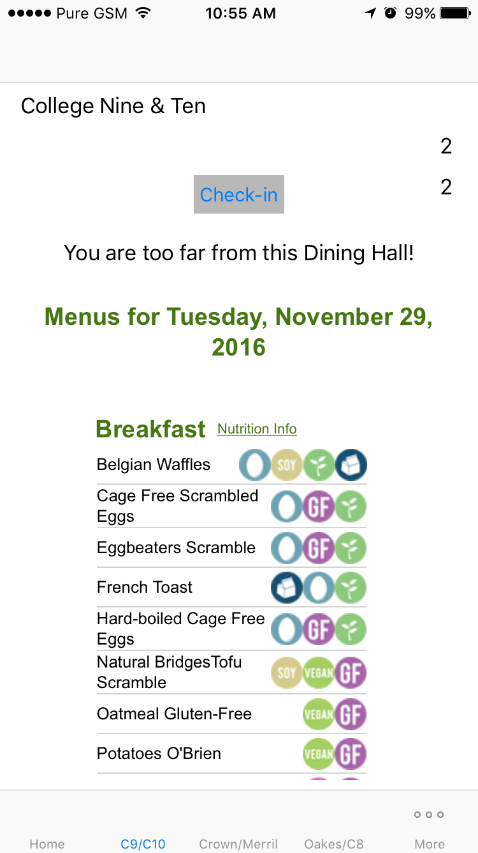
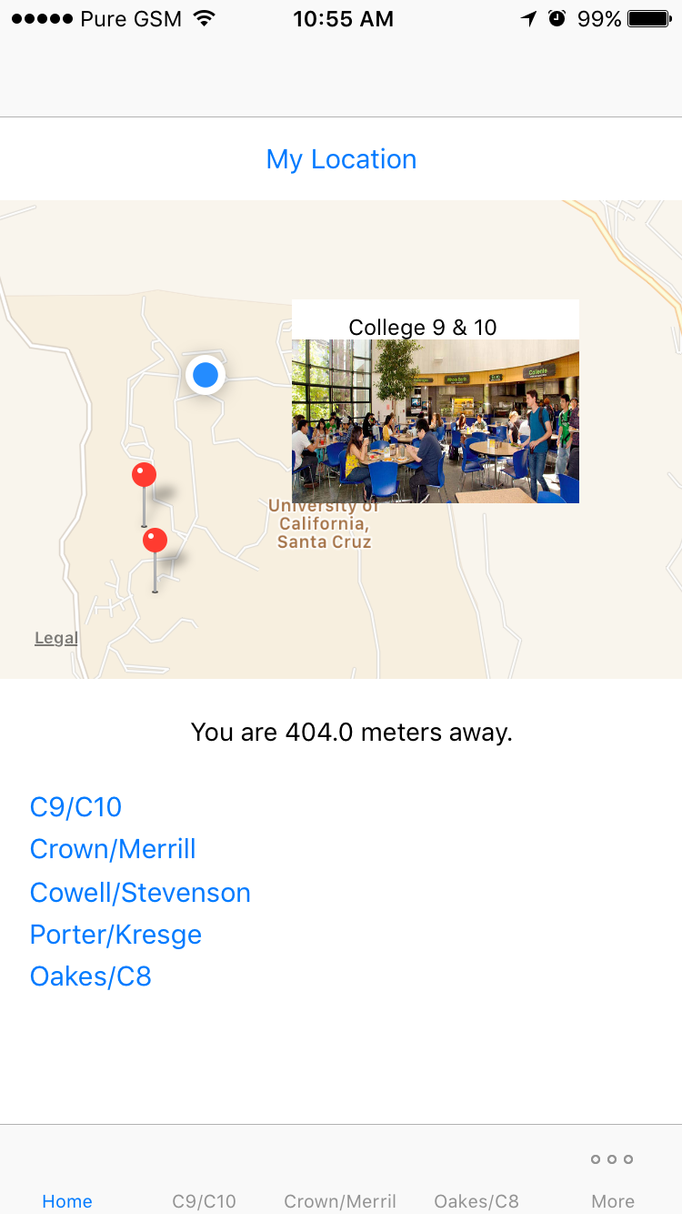

Slide 3
GOALS
What we have achieved:
To build onto current existing Slug Life platform and familiarize ourselves with app development in Swift
To make an app where students can see how far they are from a dining hall
Made an app where students can see their distance from each dining hall (visual and numerical)
Goals not met:
Counting the number of swipes into each dining hall to show impacted dining halls
Hooking up user data to the database server

Slide 4
Biggest Challenges and Accomplishments
Development Product:
Challenges | Accomplishments
Satisfying dynamic requirements from sponsor | Complete, working GPS and Map module
Learning new programming languages and technologies | Distance and check-in functions; validates voting on crowdedness
Merging code without overwriting what other group members had done | Dining hall menu

Slide 5
Biggest Challenges and Accomplishments
Development Process:
Challenges | Accomplishments
Keeping up with scrum documentation | Up-to-date Trello Board
Github Repository | Learned Scrum processes
xCode Credentials being revoked periodically significantly impedes development | Always met for Scrum meetings
Sprint 2 productivity severely reduced due to midterms | Taking new PO goals into mind when making Scrum documentation.

Slide 6

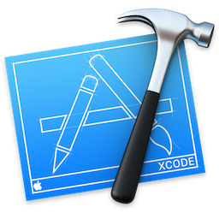


Technologies We Used
Swift 3
Xcode
PHP
MySQL
Amazon AWS Server

Slide 7




Project Management Techniques
Trello
Github
Google Drive
GroupMe
Agile Scrum Practice

Slide 8
Things We Enjoyed
App development
Creating a working, functional application
Project management techniques that are currently applicable in real-world environments
Working as a team and creating a finished product

Slide 9
Things We Didn’t Enjoy
Cross-Platform Development (relying on Virtual Machines)
Xcode
Apple Certification Renewal
Github

Slide 10
Lessons Learned
What worked?
Scrum Meetings
Sprint and Release Plans
Meeting as a group to work on the project

Slide 11
Lessons Learned
What didn’t work?
Having tasks to dependent on PO
Running a developmental environment in a virtual machine is not the ideal solution
Not everyone having an iOS device to test and run
Scapegoating: We can do it over skype later

